Slide 1



Intermediate
Programming
WEEK 8 – Inheritance and Association in Java

Slide 2


Slide 3
Inheritance
Mechanism in Java by which one class is allowed to inherit the features (fields and methods) of another class.
Terminologies
Base class - also known as super class or parent class. It is the class where the features are inherited from.
Derived class - also known as subclass or extended class or child class. It is the class that inherits from the other class. The derived class can add its own fields and methods in addition to the base class fields and methods (excluding constructors).

Slide 4
Reusability
Inheritance supports the concept of “reusability”, i.e. when we want to create a new class and there is already a class that includes some of the code that we want, we can derive our new class from the existing class. By doing this, we are reusing the fields and methods of the existing class.

Slide 5

“extends” keyword
Syntax:
class derived-class extends base-class {
// fields and methods
}
The extends keyword indicates that you are making a new class that derives from an existing class. The meaning of "extends" is to increase the functionality.

Slide 6
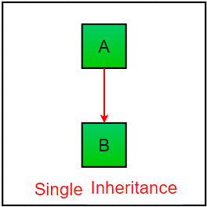
Single inheritance
In single inheritance, subclasses inherit the features of one superclass. In image below, the class A serves as a base class for the derived class

Slide 7
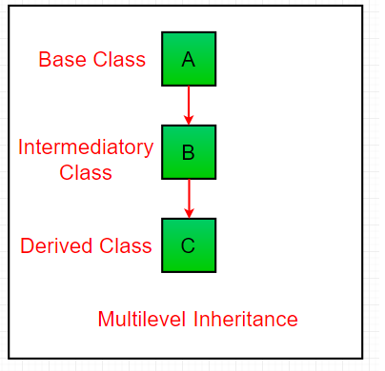
Multilevel inheritance
In Multilevel Inheritance, a derived class will be inheriting a base class and as well as the derived class also act as the base class to other class.

Slide 8
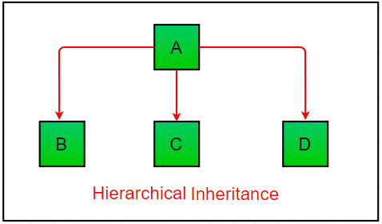
Hierarchical inheritance
In Hierarchical Inheritance, one class serves as a superclass (base class) for more than one subclass.

Slide 9
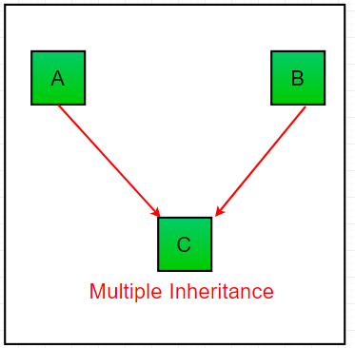
Multiple inheritance
In Multiple inheritance, one class can have more than one superclass and inherit features from all parent classes. Please note that Java does not support multiple inheritance with classes. In java, we can achieve multiple inheritance only through Interfaces.

Slide 10
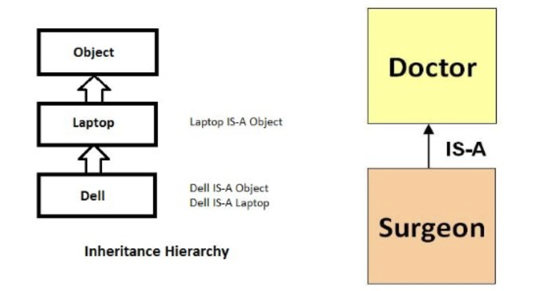
IS-A relationship
Inheritance is an IS-A relationship
It means that “one object is a type of another”

Slide 11
DEMO

Slide 12
Programming Exercise
Create an Employee class with the following attributes and methods:
Data fields: firstName, lastName, employeeID, dateOfHire, rateOfPay
Methods: work(), displayRateOfPay()
Create a subclass of Employee named HourlyEmployee and ContractEmployee
Override the method displayRateOfPay()

Slide 13
Hands-on

Slide 14
Association
Mechanism in Java which allows us to define the connection/relationship (HAS-A) of two separate classes with each other.
Forms of association
Aggregation- is a unidirectional relationship between two classes. It is a weak kind of association where one class can exist without the other.
Example: University -> Students
Composition – is a strong association between classes that denotes a PART-OF relationship. A “belongs-to” type of association.
Example: Kitchen -> House

Slide 15
DEMO

Slide 16
Intermediate
Programming
WEEK 8 – Inheritance and Association in Java

